Slide 1
Molecular imprinting (Contd)Cross-linkers
In the process of polymerization, a cross-linker is used to fix functional monomers around template molecules, thereby forming a highly cross-linked rigid polymer even after the removal of templates.
The type and the amount of cross-linker have profound influences on the selectivity and binding capacity of MIPs.
Usually, a too low amount of cross-linker will result in unstable mechanical properties due to the low cross-linking degree, and an extremely high amount of cross-linker will reduce the number of recognition sites per unit mass of MIPs.

Slide 2
Porogens
Porogens (porogenic solvents) generally act as dispersion media and pore forming agents in the polymerization process.
Usually, solvents used for MIP synthesis are 2-methoxyethanol, methanol, tetrahydrofuran (THF), acetonitrile, dichloroethane, chloroform, N,N-dimethylformamide(DMF) and toluene.
The polarity of porogens can affect the interaction between the template molecule and the functional monomer, and therefore the adsorption properties of MIPs, especially in non-covalent interaction systems.
Non-polar and less polar organic solvents, such as toluene, acetonitrile and chloroform, are often used for non-covalent imprinting to obtain good imprinting efficiency, since the adsorption properties and morphology of polymers are dependent on the types of solvents used.

Slide 3
Porogens
To evaluate the selection processes of monomers and solvents for molecular imprinting and to have an insight into MIP selectivity, the use of theoretical calculations is very important.
The effects of solvents on monomer–template binding energy using four solvents: acetone, acetonitrile, chloroform, and methanol.
Density functional theory (DFT) had been used for all structural, vibrational frequency and solvent calculations.
More recently, room temperature ionic liquids (RTILs) have been reported as an interesting class of solvents with unique characteristics.
The negligible vapor pressure of RTILs can help reduce the problem of MIP bed shrinkage and they can also act as pore templates in the polymerization reaction.
RTILs can accelerate the synthesis process, improving the selectivity and adsorption of trans-asconitic acid imprinted organic polymers.
RTILs including [BMIM][BF4], [BMIM][PF6], [HMIM][PF6] and [OMIM][PF6] attained satisfactory selectivities and rebinding capacities for propranolol MIPs.]
1-Butyl-3-methyl-imidazolium-tetrafluoroborate (BMIM BF4

Slide 4
Initiators
MIPs are commonly prepared by free radical polymerization (FRP), photopolymerization, and electropolymerization.
FRP can be initiated either thermally or photochemically for a wide range of functional groups and template structures.
Aside from the peroxy compounds, azo compounds are extensively used as initiators
Among them, azobisisobutyronitrile (AIBN) is most conveniently used at the decomposition temperatures of 50–70°C.
To ensure the polymerization reaction, removal of the dissolved oxygen from polymerization solutions immediately prior to proliferation is very important.
Oxygen can be cleared by bubbling an inert gas like nitrogen or argon.

Slide 5
Preparation procedures
The selection of an appropriate preparation procedure is critical for the production of MIPs with desirable properties.
Generally, the mechanisms of MIP preparation include free-radical polymerization and sol–gel processes.
Free-radical polymerization is more popular and general.

Slide 6
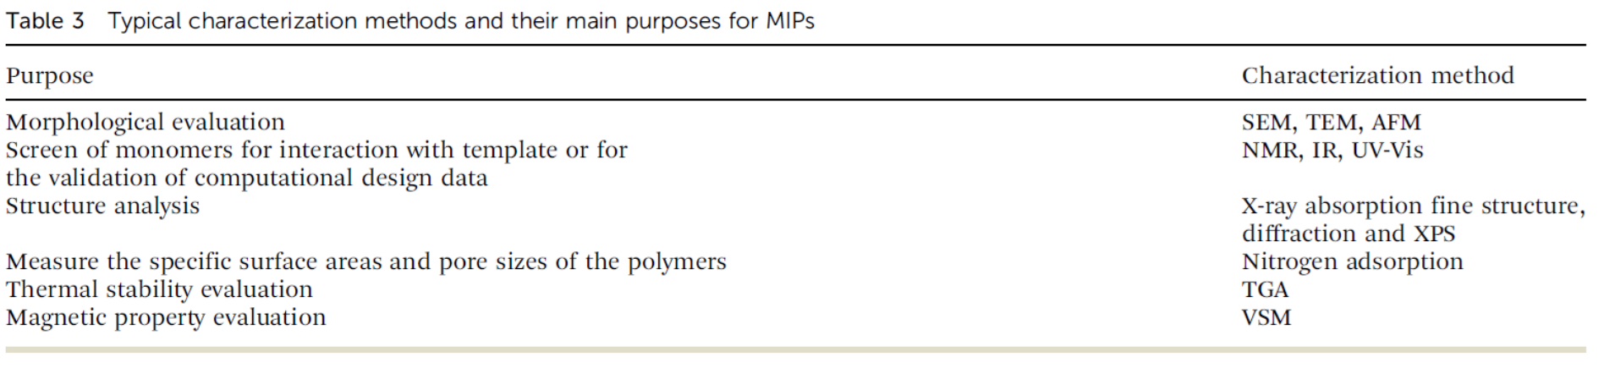
Characterization methods

Slide 7
Smart MIT for MIPs
MIPs still have many problems, such as template leakage, low binding capacity, irregular material shape, and incompatibility in aqueous media, which have greatly obstructed the applications of MIPs.
As a result, various smart preparative technologies and strategies of MIT have emerged to cope with the problems.
Smart MIT is classified into three main types, i.e., ingenious technologies (surface imprinting technology, nanoimprinting technology, etc.), special imprinting strategies (the multitemplate/ functional monomer imprinting strategy, the dummy/segment imprinting strategy, etc.) and stimuli-responsive imprinting technologies (magnetic/thermo-responsive technology, dual/multi responsive technology, etc.), have been developed.

Slide 8
Surface imprinting technology
Mosbach, first reported the surface imprinting technology to prepare imprinted materials by controlling templates to locate at the surface or in the proximity of materials’ surface to create more effective recognition sites.
The complete removal of template molecules and good accessibility to target molecules,
Especially suited for imprinting macromolecules, such as proteins, cells and viruses, since their large sizes usually hinder the templates from both leaving and rebinding the imprinted sites in traditional MIPs.
For example, bovine serum albumin (BSA) as the template protein was immobilized on the surface of silica nanoparticles to synthesize the surface modified MIPs.
The results showed excellent selectivity and recognition ability for the protein template, as many specific recognition sites for the protein template were generated on the surface of MIPs.

Slide 9
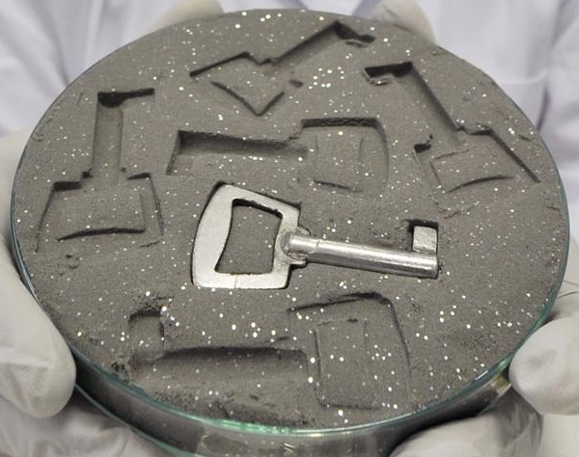
Surface Molecular Imprinting
Classical approach: incorporate template and monomers all together
Difficulty in removing template
Rapid binding kinetics
Traces of template being easily removed
More flexible incorporation of multifunctionality
High surface-to-volume ratio, High level of specific binding sites
Better control of manufacturing process
“Lock-key”
Molecular lock
Adv. Mater. 2019, 1806328; Chem. Soc. Rev., 2016, 45, 2137--2211
http://nice.asu.edu/nano/molecular-imprinted-polymers-mip

